Slide 1
Visual analytics - Homework 1
Francesco fortunato - 1848527

Slide 2
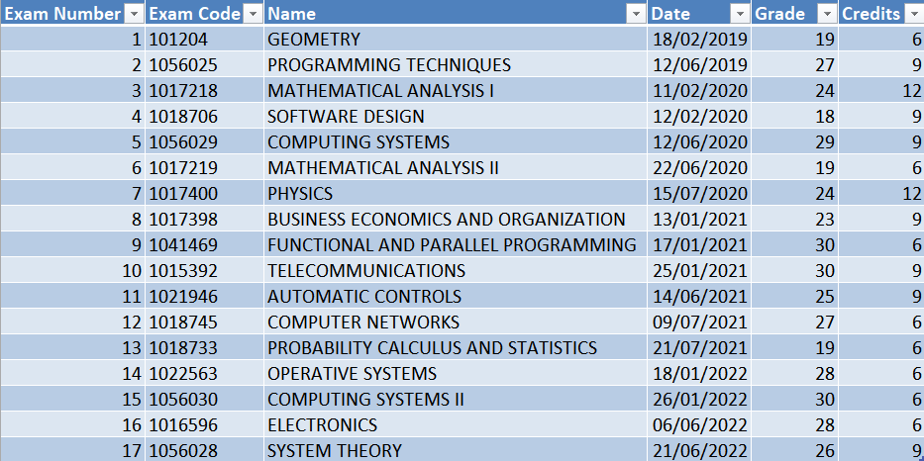
Collect all the scores of bachelor exams

Slide 3
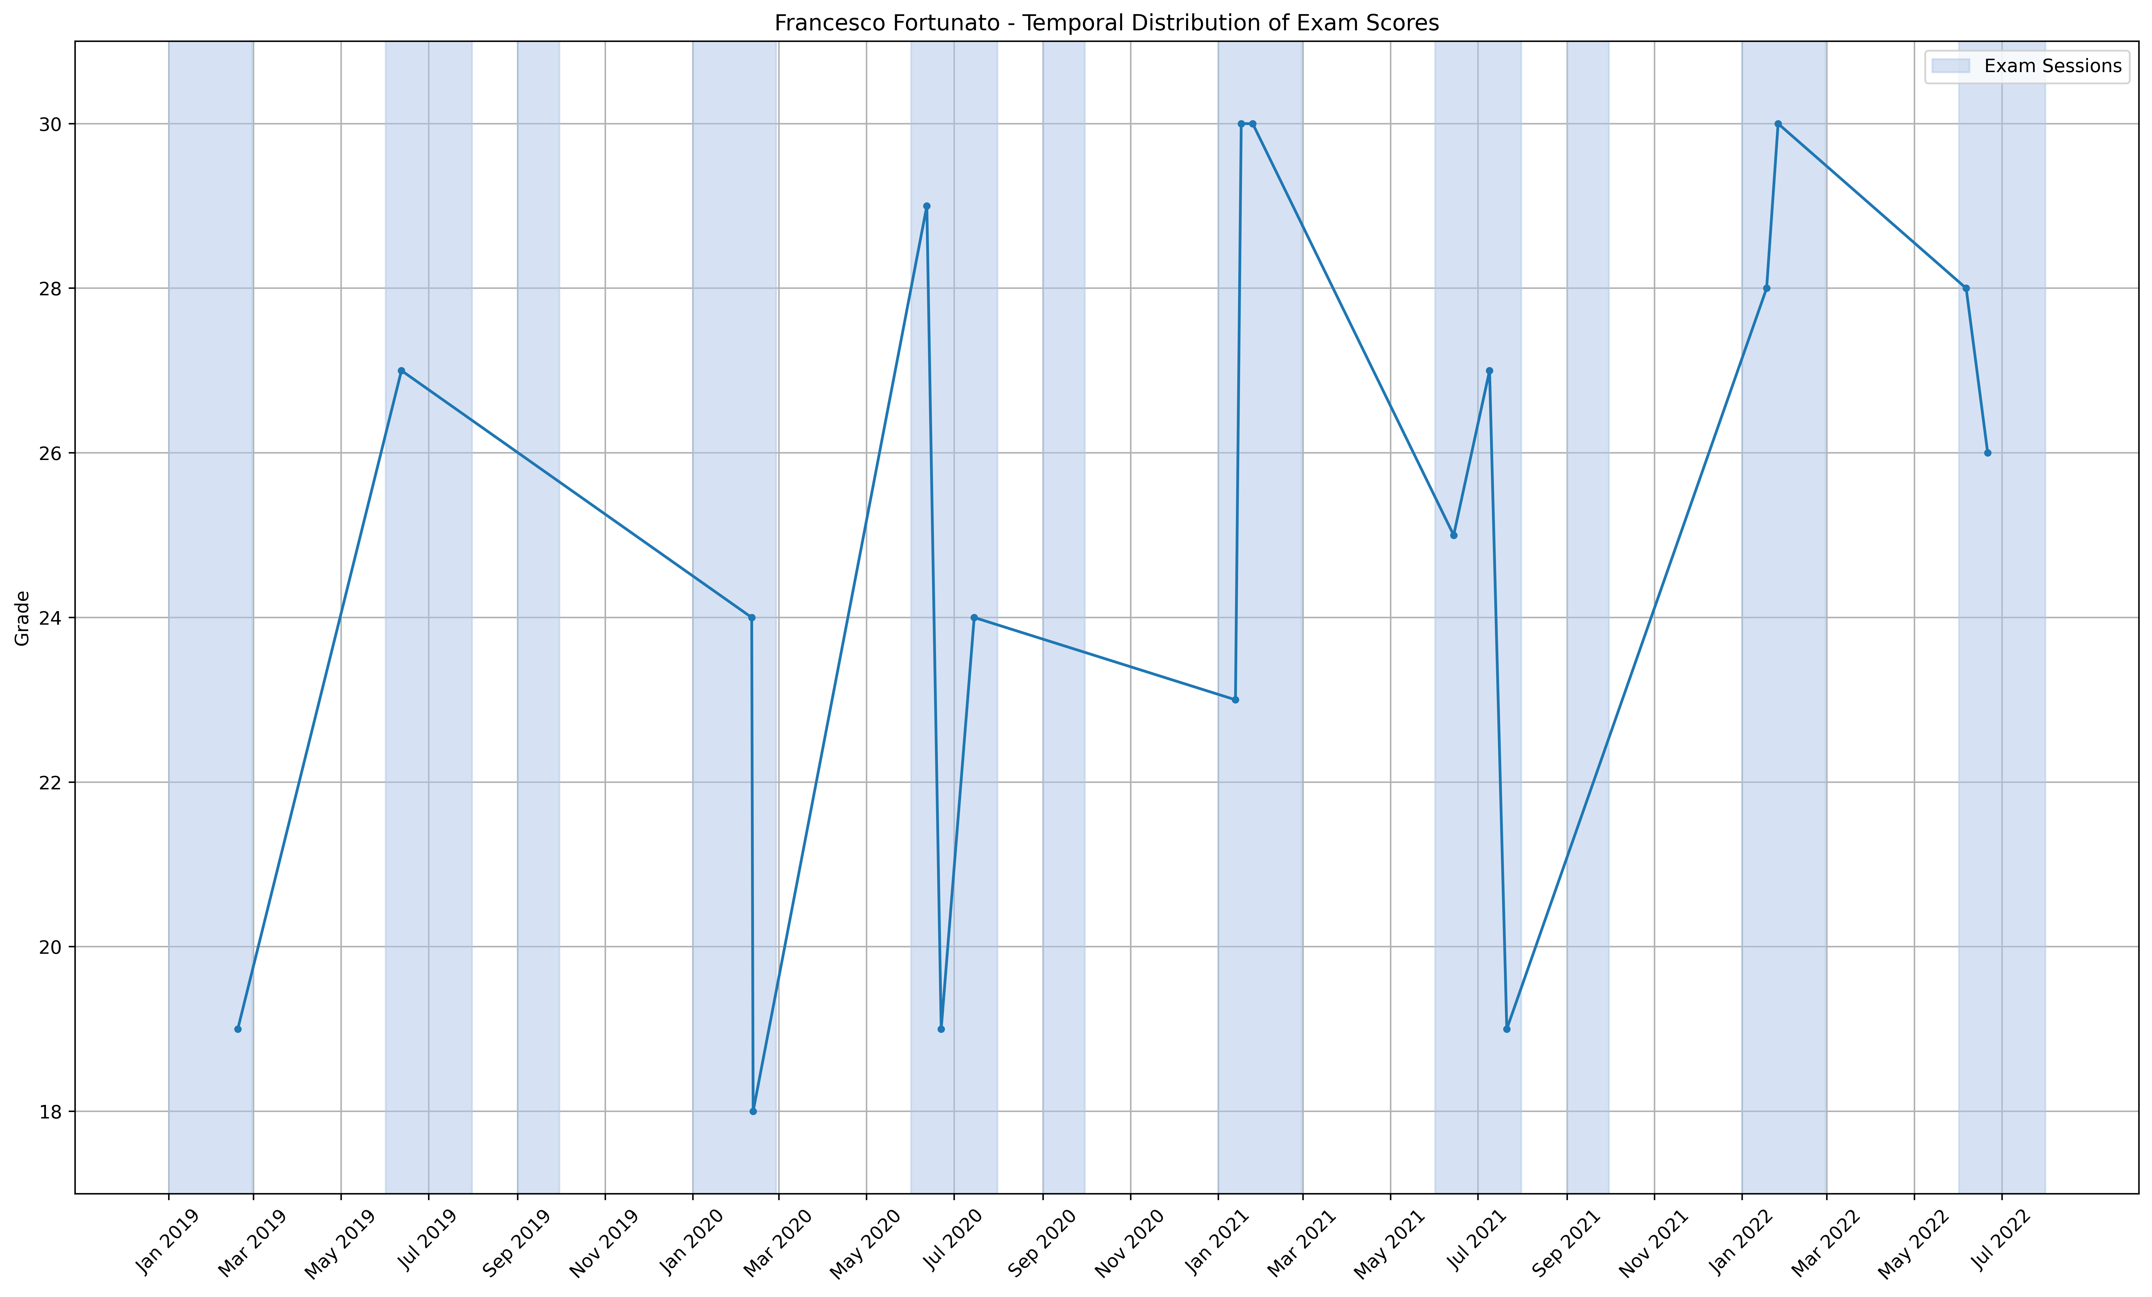
Temporal Distribution
Data Classification
Data Types: Numerical (exam scores), Time Series (dates).
Relationships: Temporal distribution of exam scores.
Visual Variables
X-axis: Time (Jan 2019 - Aug 2022).
Y-axis: Exam Scores (18-30).
Line and markers: temporal distribution
Plot Description
The plot shows the temporal distribution of exam scores over time.
Each data point represents an exam score.
Shaded regions indicate exam sessions in January/February, June/July, and September.
X-tick labels are formatted as 'Month Year' for clarity.
Analysis
The scores fluctuate very much over time
Over time, academic performance shifted: In the first half (before 2021), three exams scored under 22 and only one over 28. In the second half (from 2021 onward), just one scored under 22, while five exceeded 28.

Slide 4
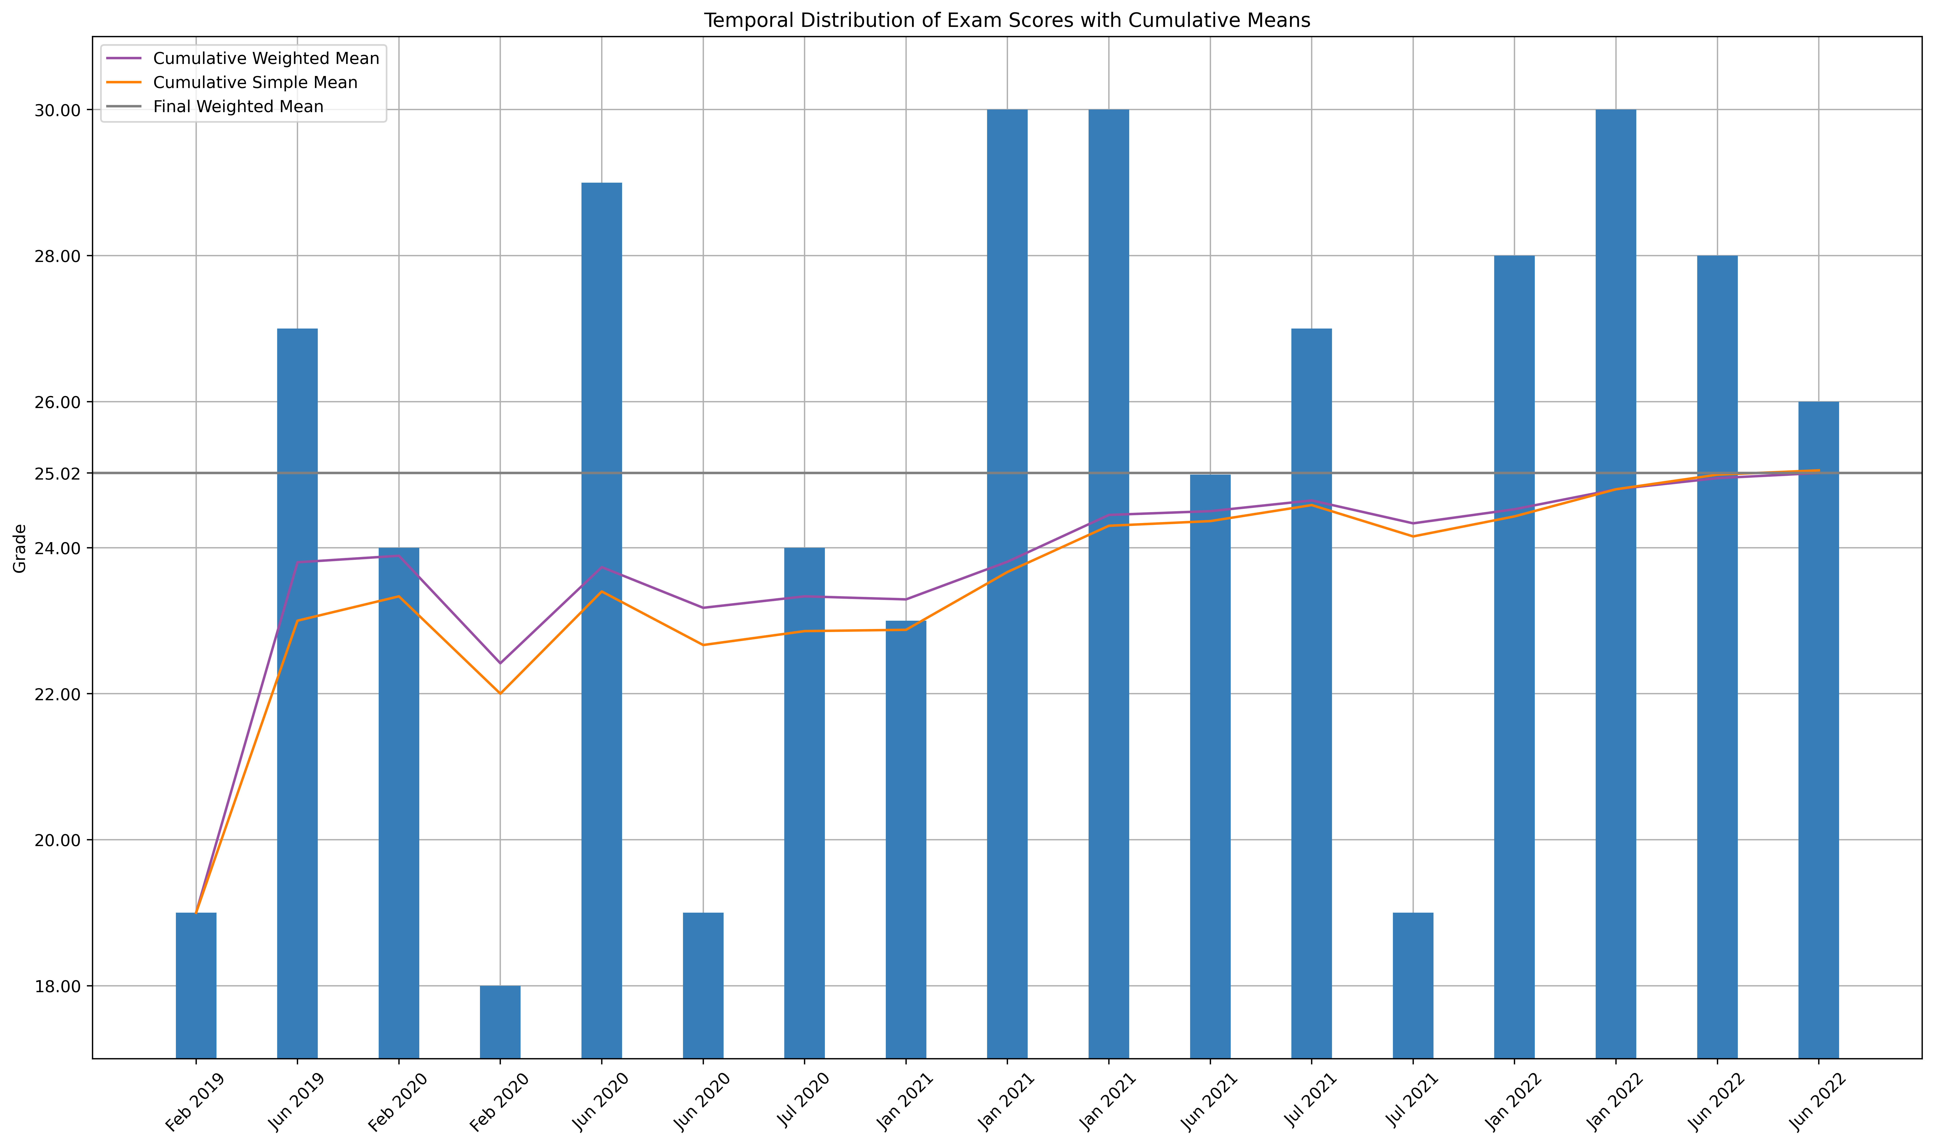
Local and global performance
Data Classification
Data Types: Numerical (exam scores, credits), Time Series (dates)
Relationships: distribution of exam scores and cumulative performance.
Quantitative Variables: Exam scores, cumulative mean, cumulative weighted mean.
Visual Variables
X-axis: Time (Jan 2019 - Aug 2022).
Y-axis: Exam Scores (18-30).
Bars: Exam scores.
Lines: Cumulative Weighted Mean and Cumulative Simple Mean.
Plot Description and Analysis
The plot shows the local and global performance of exam scores over time.
Each bar represents exam scores at a session.
Lines indicate Cumulative Weighted Mean and Cumulative Simple Mean and final Weighted Mean.
We can see the important improvement over the time, along with the difference between simple and average means.

Slide 5
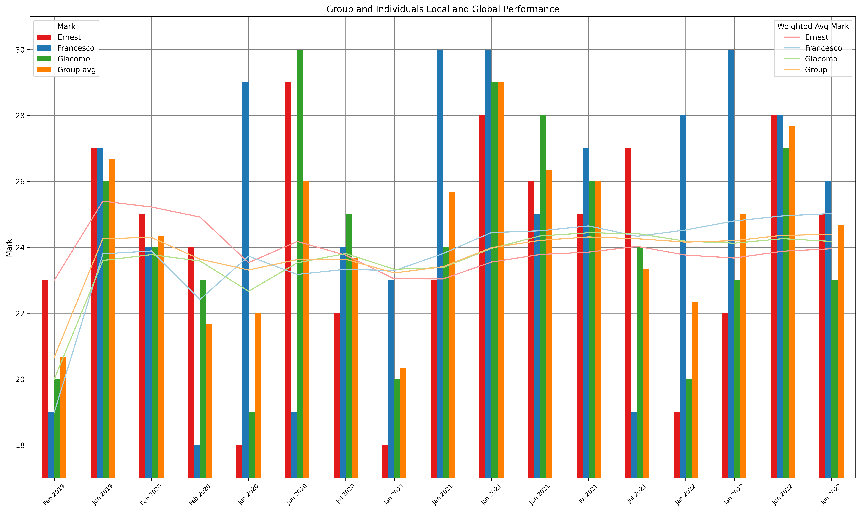
Individual Local and global performance
Data Classification
Data Types: Numerical (exam scores, credits), Time Series (dates)
Relationships: distribution of exam scores and cumulative performance.
Quantitative Variables: Exam scores, group mean, cumulative means, cumulative weighted means.
Visual Variables
X-axis: Time (Jan 2019 - Aug 2022).
Y-axis: Exam Scores (18-30).
Bars: Exam scores.
Lines: Cumulative Weighted Mean and Cumulative Simple Mean.
Colors: Different colors for each person.
Plot Description and Analysis
The plot displays the local performance of individuals in exams over time.
Each bar represents an individual's performance on different exams.
Cumulative Weighted Mean lines show performance trends for each person.
We can see important variations between individuals over the time, along with the difference between average means. We can clearly observe exams where individuals have similar marks, as well as exams with significant differences in their scores.

Slide 6
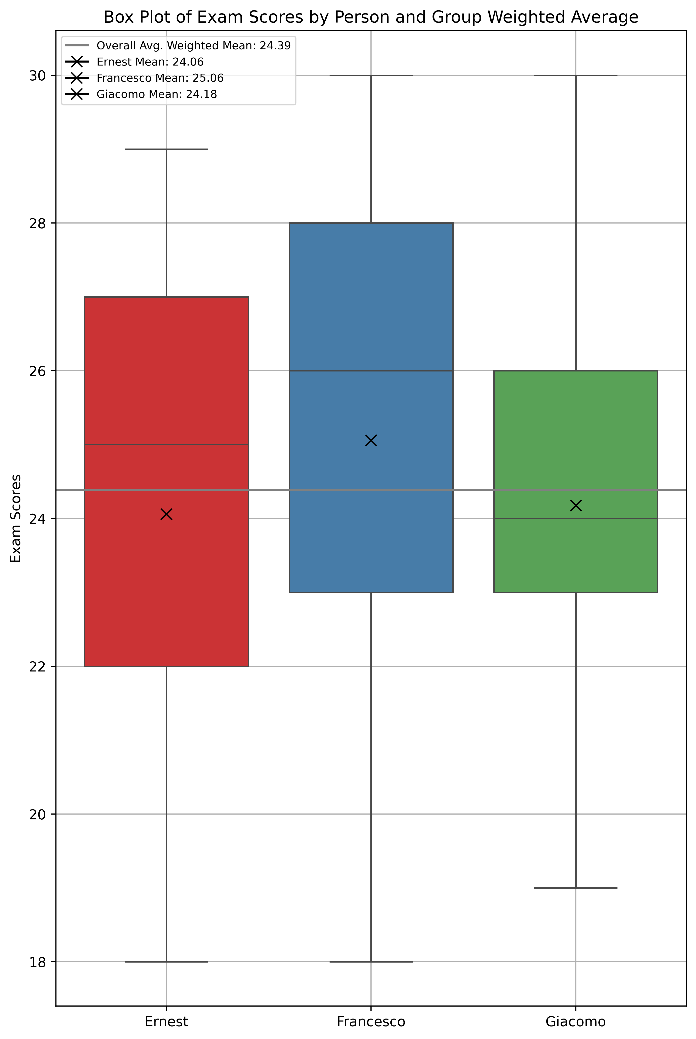
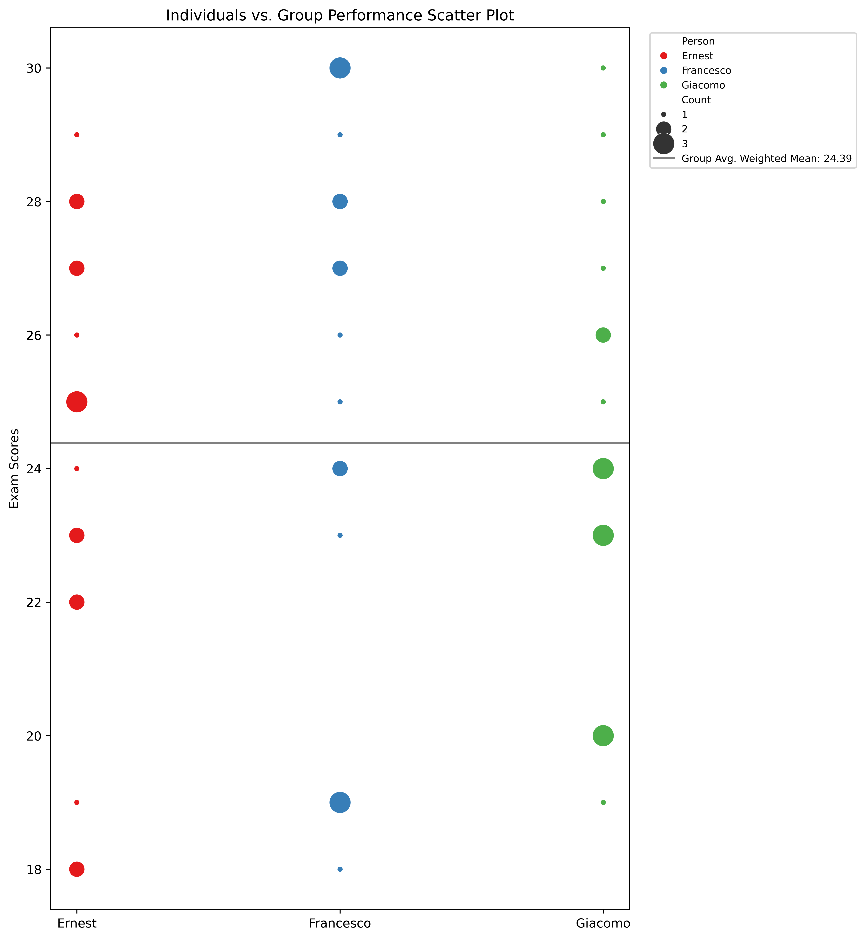
A different view: Box plot and scatter plot
Box Plot
Data Classification
Data Types: Numerical (exam scores), Categorical (persons).
Relationships: Comparison of exam scores.
Visual Variables
X-axis: Person.
Y-axis: Exam Scores.
Plot Description
The box plot shows the distribution of exam scores for different individuals.
It provides insights into score variations among individuals.
Analysis
The plot helps identify variations in exam scores.
It allows comparisons of exam performance between individuals.
Scatter Plot
Data Classification
Data Types: Numerical (exam scores), Categorical (persons).
Relationships: Comparison of individual and group performance.
Visual Variables:
X-axis: Person.
Y-axis: Exam Scores.
Marker Size: Exam Count.
Plot Description:
The scatter plot compares individual exam scores with group performance.
Marker size represents the count of exams.
Analysis:
It helps understand how individuals perform compared to the mean of the group.
Exam count aids in recognizing prolific performers.

